Slide 1
Python code Used in Data Science: Screen Scraping & Rest API
Jeremy Bergmann - Omaha Data Science Academy

Slide 2

Python/Data Science Code - Pandas
Pandas - high-performance, easy-to-use data structures and data analysis tools, including:
DataFrame object for data manipulation
Tools for reading and writing data
Intelligent data alignment and handling of missing data
Flexible reshaping and pivoting of data sets
Slicing, fancy indexing, and subsetting of large data sets
Aggregating or transforming data with “group by” engine
Merging and joining of data set
Time series-functionality
Documentation: http://pandas.pydata.org/pandas-docs/stable/

Slide 3
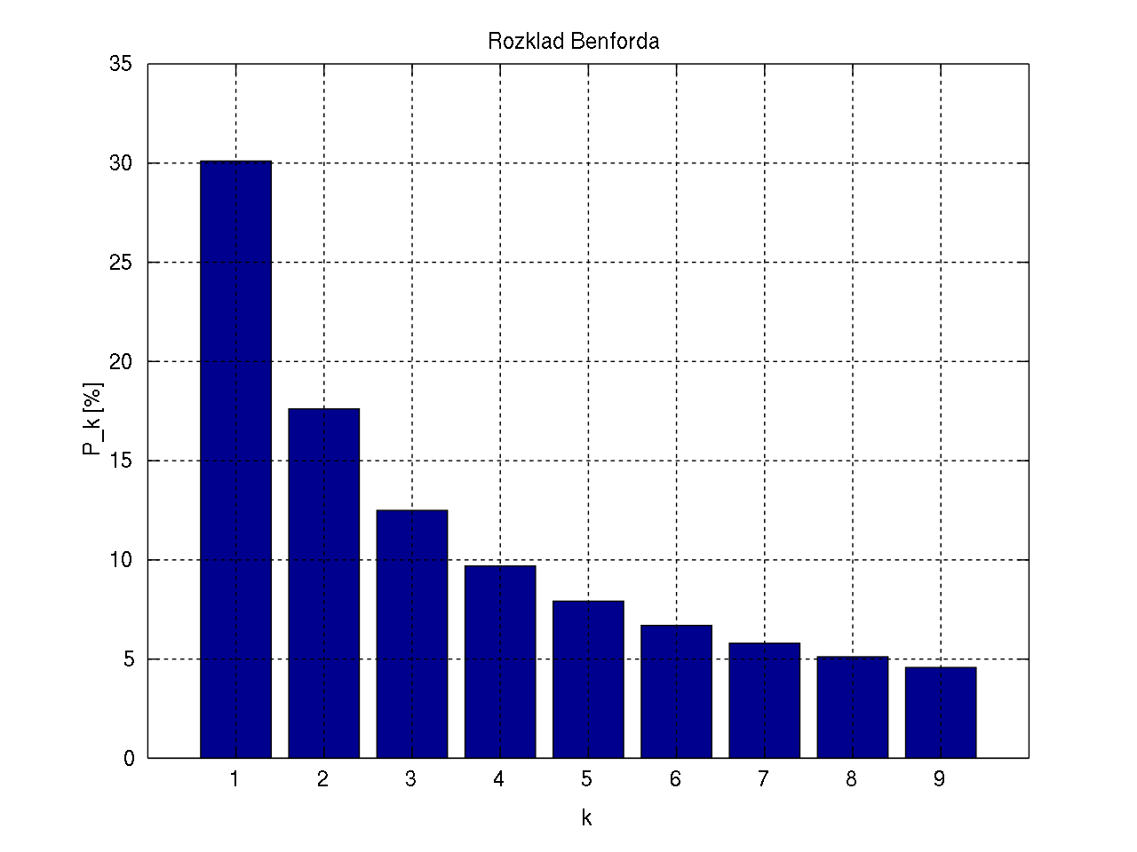
Python/Data Science Code - Benford’s Law
Benford’s Law - In many naturally occurring collections of numbers, the leading significant digit is likely to be small.
Expected in: Transaction data, Numbers that result from combo on #’s (quantity x price)
Not Expected in: Sequential Numbers, Influenced by human thought ($1.99)
Applications: Fraud Detection, Genome size
Class Example: https://github.com/milcent/benford_py.git
The distribution of first digits, according to Benford's law. Each bar represents a digit, and the height of the bar is the percentage of numbers that start with that digit.

Slide 4
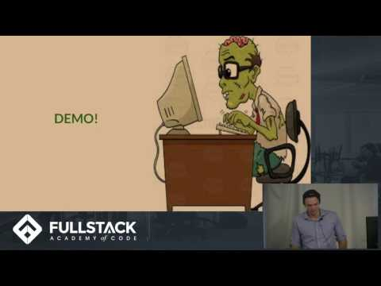
Screen Scraping
Screen/data scraping: Used for extracting unstructured data from websites, then transforming it into a readable, analyzable format.
Need arises when data is not readily available via “structured” data sources, such as databases, files and REST APIs.
Knowledge of HTML & JavaScript is Useful!
Typical Screen Scraping Steps:
Making Web Requests
Inspect Data Source
Wrangling/Transforming HTML Elements
Cleansing/Structuring Data for Storage
Using Selenium w/Python: https://www.guru99.com/selenium-python.html
Documentation: https://selenium-python.readthedocs.io/

Slide 5
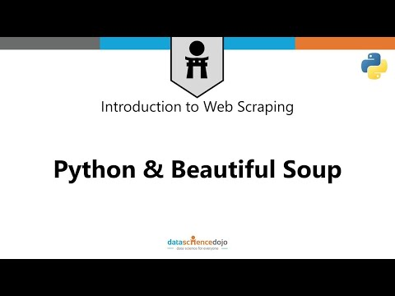
Python Screen Scraping - Requests + BS4
Beautiful Soup (BS4): Beautiful Soup is a Python package for parsing HTML and XML documents, and creates a parse tree that be used to extract data from HTML markup.
Requests: Python HTTP library, released under the Apache2 License. The goal of the project is to make HTTP requests simpler and more human-friendly.
Tutorial :https://medium.freecodecamp.org/how-to-scrape-websites-with-python-and-beautifulsoup-5946935d93fe
Beautiful Soup Documentation: https://www.crummy.com/software/BeautifulSoup/bs4/doc/

Slide 6
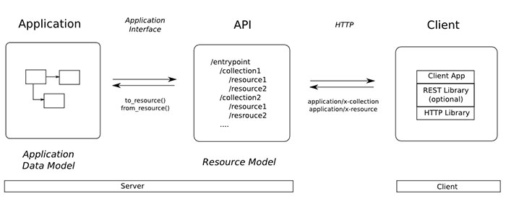
Rest API Requests
A RESTful API is an application program interface (API) that uses HTTP requests to GET, PUT, POST and DELETE data.
RESTful APIs are used by such sites as Amazon, Google, LinkedIn and Twitter.
Typical Rest API Request steps:
Identify Resource & Endpoints
Access Endpoints & Methods
Parameters
Request
Response & Parsing
Learning Resource: https://idratherbewriting.com/learnapidoc
API Example: https://developer.box.com/reference
Notes:
In computer programming, an application programming interface (API) is a set of routines, protocols, and tools for building software and applications. it is a set of clearly defined methods of communication among various components. A good API makes it easier to develop a computer program by providing all the building blocks, which are then put together by the programmer.

Slide 7
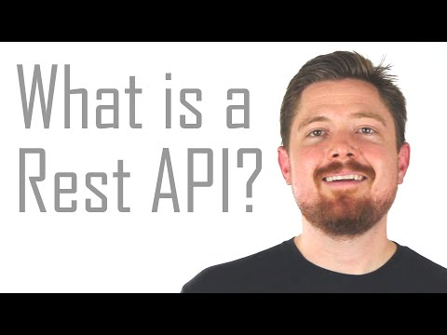
Tutorial - Rest API
Notes:
In computer programming, an application programming interface (API) is a set of routines, protocols, and tools for building software and applications. it is a set of clearly defined methods of communication among various components. A good API makes it easier to develop a computer program by providing all the building blocks, which are then put together by the programmer.

Slide 8
Python Requests
Requests will allow you to send and receive HTTP/1.1 requests/responses using Python, by:
Making a Request
Working with Response Code
Get the Content
Working with Response Headers
Encoding/Decoding
Custom Headers
Redirection and History
Errors and Exception Handling
https://www.pythonforbeginners.com/requests/using-requests-in-python
Notes:
In computer programming, an application programming interface (API) is a set of routines, protocols, and tools for building software and applications. it is a set of clearly defined methods of communication among various components. A good API makes it easier to develop a computer program by providing all the building blocks, which are then put together by the programmer.

Slide 9
Exercise - Data Scraping + Rest API
Data Scraping
Download HTML of the Yahoo Finance “S&P” historical stock page using the Python Requests package
Inspect Data Source via web browser (IE) and Python (Print, BS4 Lib)
Parse the page using BS4 HTML Parser + HTML Tag Information
Save the data for Storage - CSV & JSON
Rest API - Google Fusion Table
Obtain Google OAuth token for API developer usage.
Utilize the Fusion Tables “Replace” endpoint, using POST method
Load the S&P Historical Data from CSV, then create the response body for the endpoint/method in (2)
Receive response data confirming successful request, then check fusion table

